Slide 1
EITI Summary data template
Introduction to the Summary data template 2.0

Slide 2
Contents
Introduction
Summary data 2.0: functions and trends
Use of summary data files and templates

Slide 3


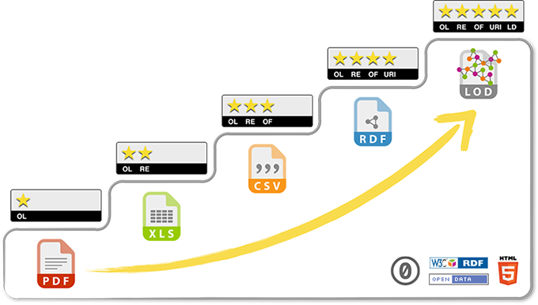
1. Introduction
Encouraged for national EITI
Requirement 7.2 Data accessibility and open data
Implementing countries [MSGs] should ensure that EITI disclosures are made publicly accessible. The [MSG] should:
Agree open data policy on the access, release, and re-use of EITI data. Government agencies and companies are expected to publish EITI data under an open license, and to make users aware that information can be reused without prior consent.
Make the data available in an open data format online and publicise its availability. Open data format means that data can be made accessible in CSV or Excel format and contain all tables, charts and figures from EITI Reports.
Complete summary data files for each fiscal year covered by the EITI in accordance with the template approved by the EITI Board [Summary data template].
The [MSG] is encouraged to make systematically disclosed data machine-readable and inter-operable, and to code or tag EITI disclosures and other data files so that the information can be compared with other publicly available data.
Also part of Standard ToR for IAs
Expectation of govt / comps
Required for national EITI
The 5-star open data description, https://5stardata.info/en/
https://eiti.org/summary-data-template
Notes:
Insist: National Secretariat and MSG are responsible for the submission of EITI summary data. However, For countries that still hire Independent Administrators, this is still a specific deliverable in the Standard ToRs.

Slide 4
1. Introduction: A brief history of data
History:
Pre-2015: No open data
2015: Open data policy agreed
2016: Open data requirements
2018: Systematic disclosure expectation
2019: 90% open data coverage
EITI Open data policy
EITI disclosures: 2005 - Q2 2019

Slide 5
1. Introduction
As national MSGs ask government and companies to report data for EITI Reporting, so does the EITI Board of its implementing countries.
Summary data covers 5 parts:
Part 1 (About) covers the basic countries and data characteristics
Part 2 (Disclosure checklist) covers contextual and aggregate financial data for EITI Requirements 2-6, and whether the information is systematically disclosed
Part 3 (Reporting entities) lists reporting entities (Government agencies, companies and projects) and related information.
Part 4 (Government revenues) contains the full government disclosures of extractive sector revenues, according to IMF’s GFS classification.
Part 5 (Company data) contains company- and project-level data per revenue stream.

Slide 6
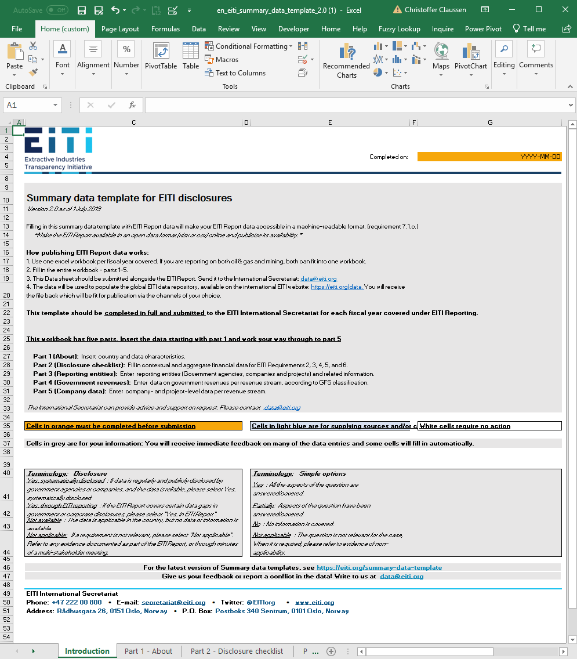
2. Summary data 2.0
Functions:
Extensive guidance included
More data standardisation
Multiple “sorting” options
Takes on recent trends:
Expanded data on auditing, legal framework, SOE, beneficial ownership
Includes project-level reporting
Systematic disclosure questionnaire

Slide 7
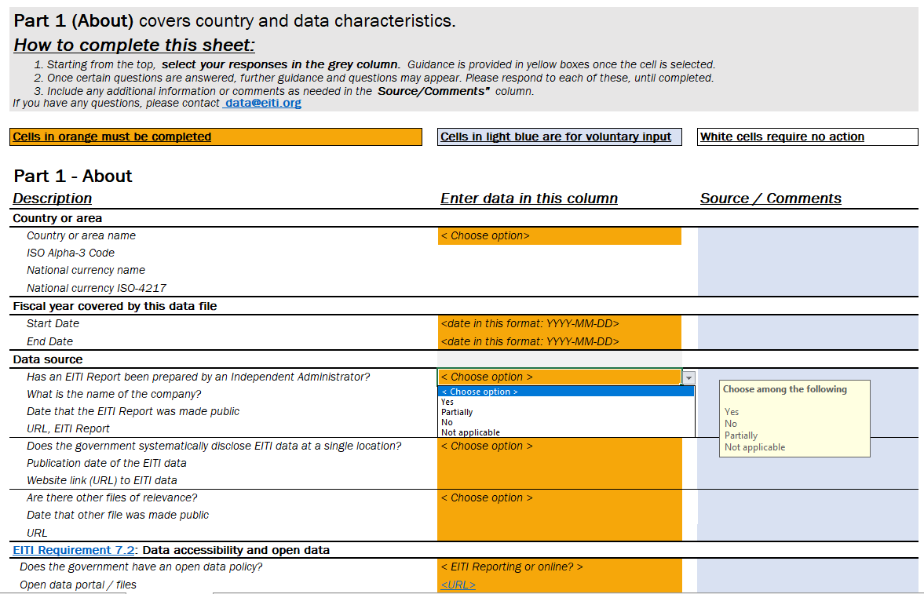
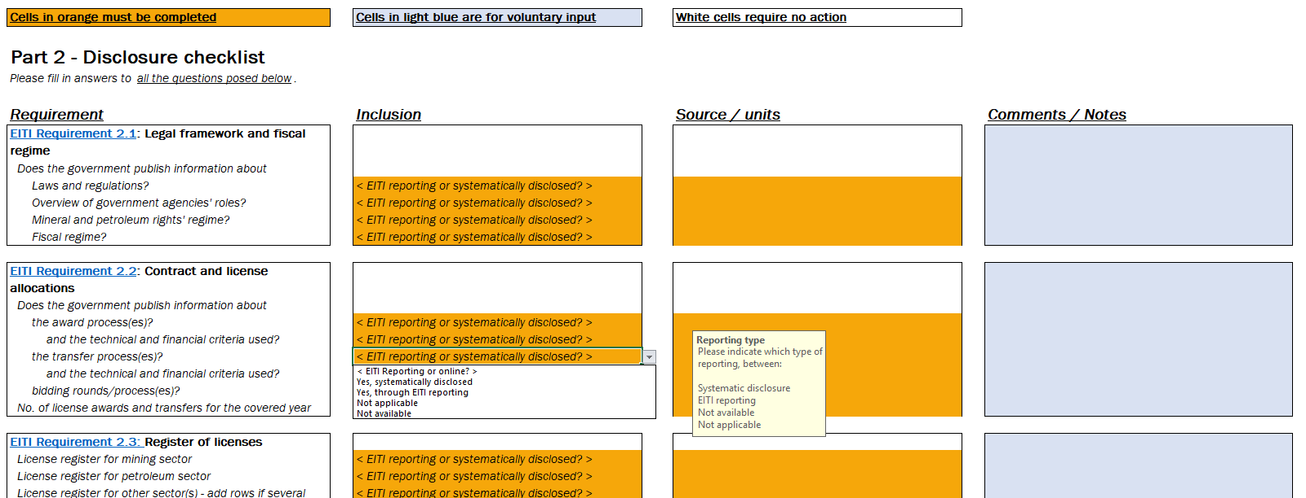
2. Summary data 2.0
Includes guidance for each cell, and standard responses for several
Simple options:
  Yes: all aspects are covered
  Partially: Some aspects have been answered / covered
  No: No aspects are covered
  Not applicable: The question is not relevant (requires the explanation of non-applicability)
Reporting options:
  Systematically disclosed: If all data is regularly disclosed, is comprehensive and of sufficient quality
  EITI Reporting: If the EITI Report covers one or more data gaps in government or corporate disclosures
  Not available: The issue is relevant, but data is not available
  Not applicable: The question is not relevant (including documentation of non-applicability)
2.
1.
3.

Slide 8
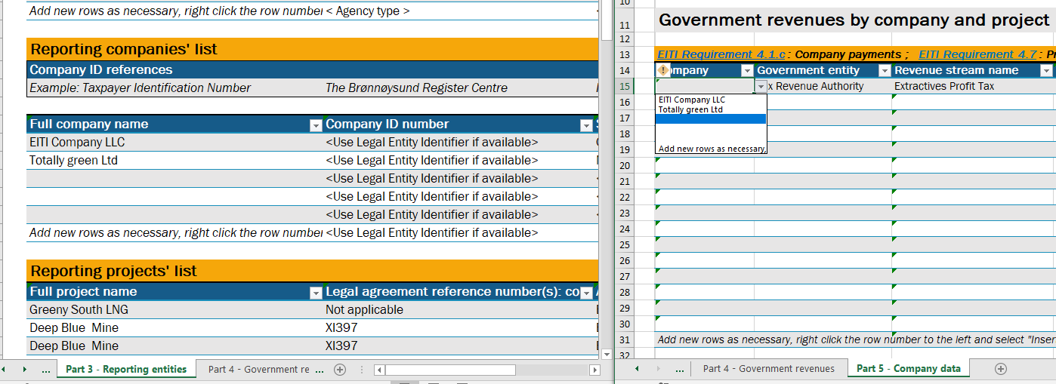
2. Summary data 2.0
Cells in orange must be completed
Cells in light blue are for voluntary input
White cells require no action
What you input in one list, it influences another (internal standardisation)

Slide 9
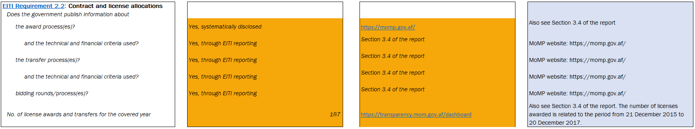
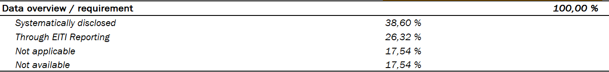
2. Summary data 2.0
Certain overviews are automatic:
% requirements systematically disclosed
Reconciliation coverage
Revenue totals
Notes:
Award processes are publicly available on the website of the ministry
But technical and financial criteria were published in the EITI Report: EITI Reporting fill the disclosure gaps within government systems.
The “not available” percentage may indicate that some data points are not available.

Slide 10
2. Summary data 2.0
Uses international data standards:
ISO Alpha country codes
ISO-4217 currencies
Harmonised system commodity codes
Government Finance Statistics (GFS)
LEI (encouraged) for companies

Slide 11
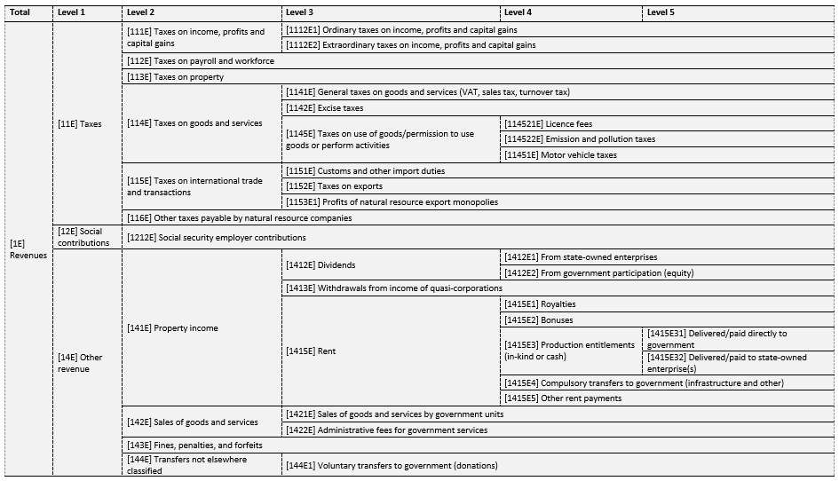
Government finance statistics (GFS) of IMF
Built on IMF’s standard classification.
Each lower category / level is signified by new digit
1 Revenues = 11 Taxes + 12 Social contributions + 14 Other revenues
“E” signifies extractive-specific classification:
1415 Rent – standard classification
1415E1 Royalties – EITI / extractive-specific rent

Slide 12
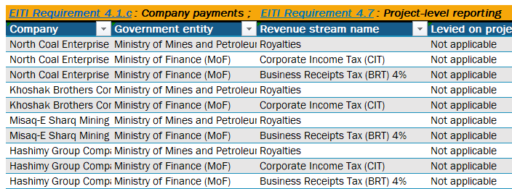
2. Summary data 2.0
A vast majority of data points can be sorted to focus on certain aspects of the different data sets.
Revenue data can be sorted by company, government agencies, revenue stream or project.

Slide 13
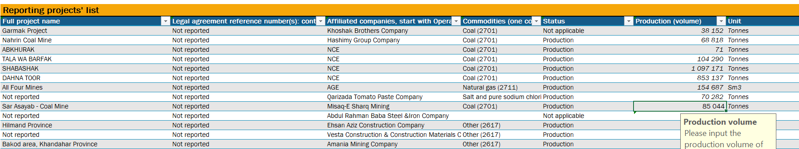
2. Summary data 2.0
Enables project-level reporting:
Revenues, Production, Commodities, Companies affiliated

Slide 14
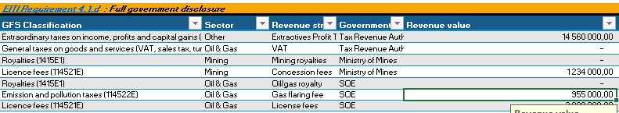
2. Summary data 2.0
Revenues can now be broken down by sector

Slide 15
3. Use of summary data
Use of the template (internal/partners):
Can be used as a mapping tool for systematic disclosures:
Part 2 is questionnaire for type of disclosure for each requirement of the Standard, including the primary source.
Can be used as a pre-validation exercice to spot existing gaps in disclosures.
Notes:
By either colleagues or National Secretariats
By either colleagues or National Secretariats
Filling in the template has a value in itself

Slide 16
Use of summary data
Open data (summary data files finalized)
Feed the visualisations of EITI website: production, exports, payments and government agencies
Support and inform partners’ work (external data users)
Economic contribution:
How resource dependent is my country?
Need some data? Ask us!
Notes:
Pull out the queries:
SOEs and Validation: linking two EITI databases together: https://eiti.org/document/stateowned-companies-validation
2) Economic contribution: https://shared.eiti.org/_layouts/15/WopiFrame2.aspx?sourcedoc=/Shared%20Documents/Not%20country-specific/Summary%20Data/1-%20API%20queries/190225%20-%20API%20Query%20-%20Economic%20Contribution.xlsx&action=default
3) Economic contribution per capita (open data power: we can link our data to other databases, such as world bank): https://shared.eiti.org/_layouts/15/WopiFrame.aspx?sourcedoc=/Shared%20Documents/Not%20country-specific/Summary%20Data/1-%20API%20queries/190710%20-%20API%20Query%20-%20Economic%20Contribution_percapita.xlsx&action=default
4) Outreach? : https://shared.eiti.org/_layouts/15/WopiFrame.aspx?sourcedoc=/Shared%20Documents/Not%20country-specific/Summary%20Data/1-%20API%20queries/190712%20-%20Natural%20resource%20rents%20coverage.xlsx&action=default

Slide 17
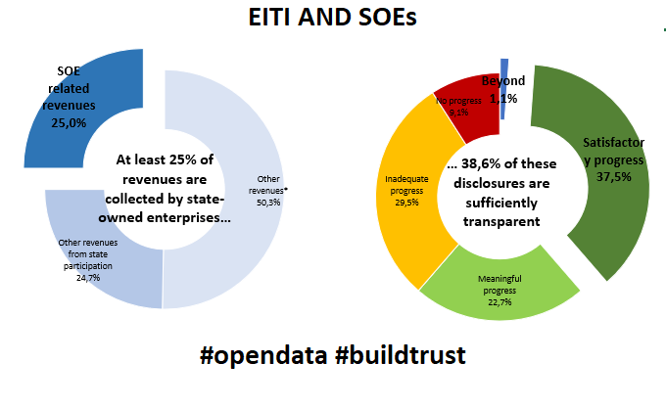
SOEs and Validation

Slide 18
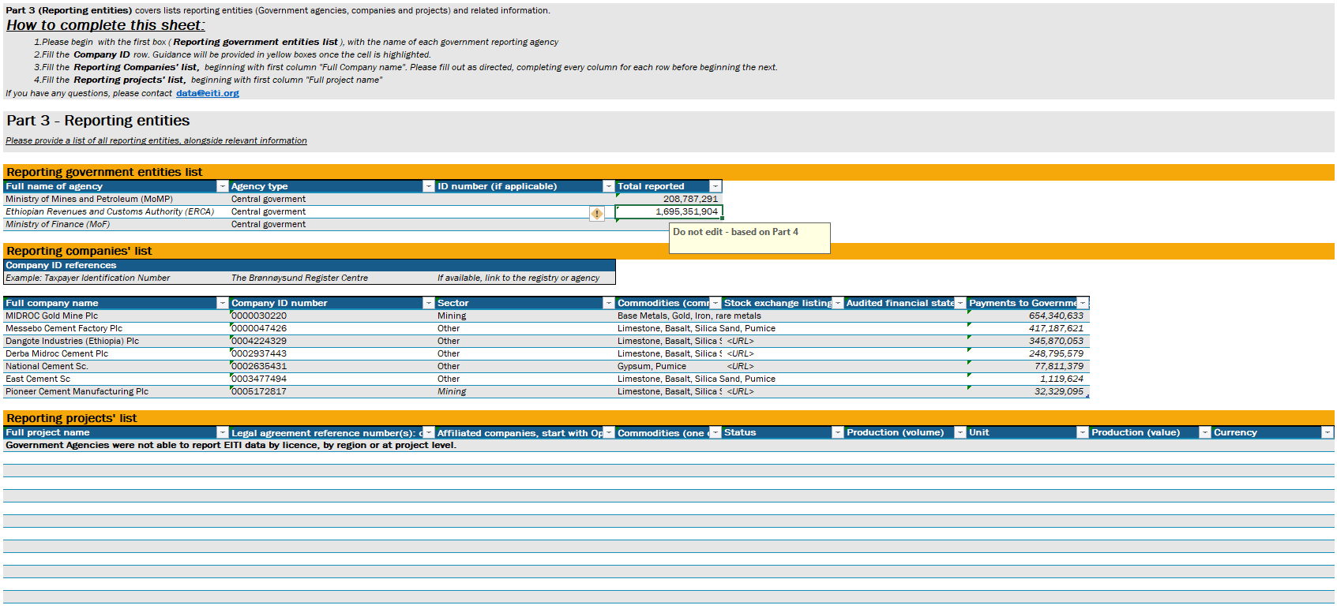
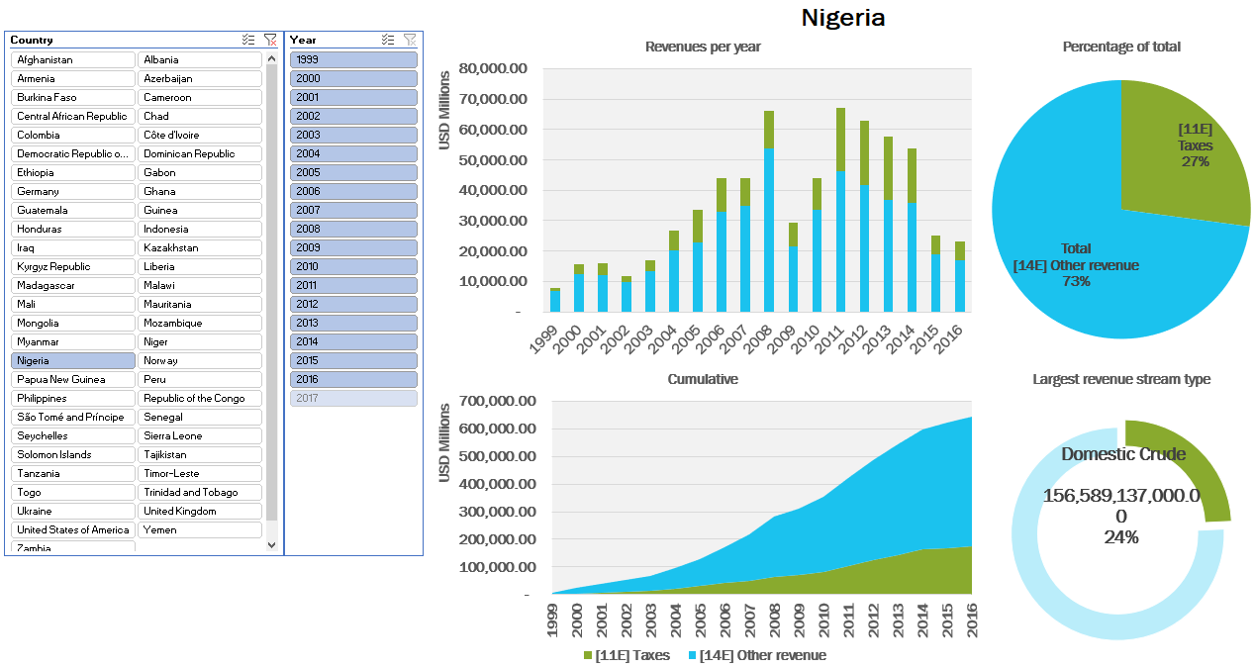
Examples:
Ethiopia’s FY16/17 Summary data: https://drive.google.com/drive/folders/0B361RU22DTPfVWhTX3pDZ0ZrZnM
Revenue profiles of EITI countries: https://eiti.org/sites/default/files/191009_-_revenue_profiles_clean.xlsx

Slide 19
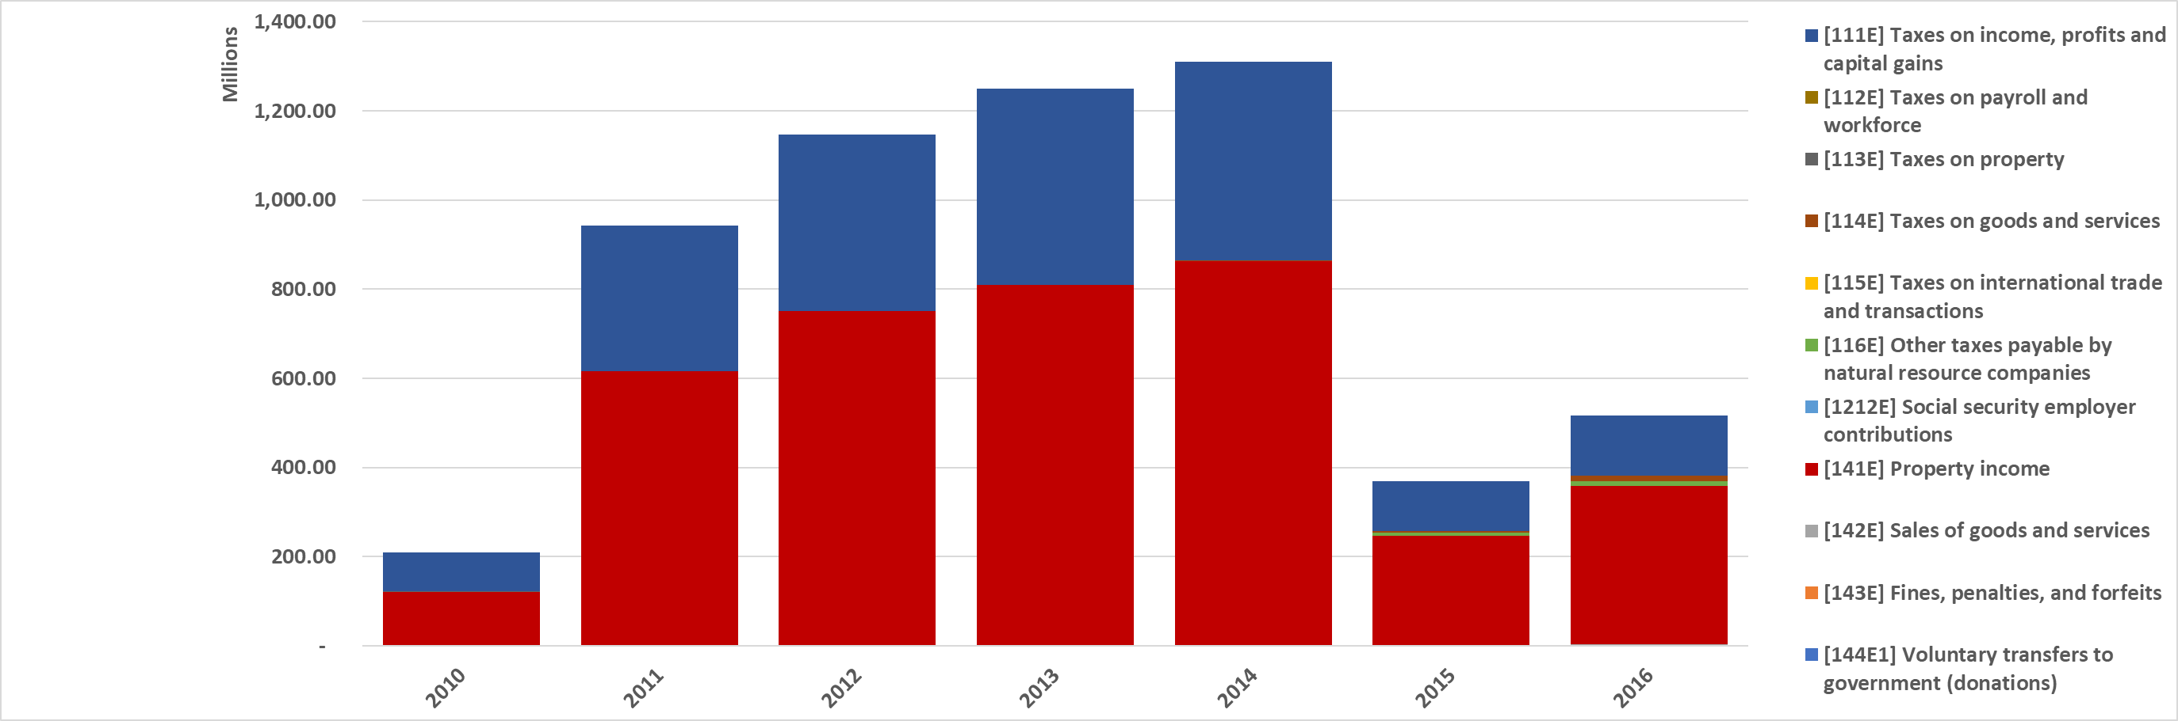
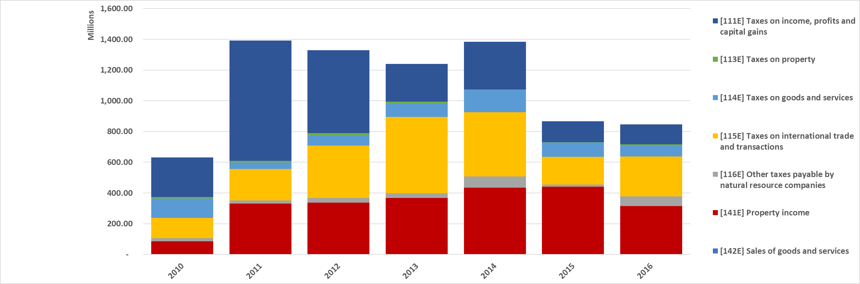
GFS revenue profiles
Comparison between extractive revenue profiles between Ghana and Zambia
Notes:
Thanks to country submissions, we can now develop analysis tools, such as revenue profiles for countries:
Ghana gets between 2/3 and ¾ of its revenues through property income (), the rest being Taxes on income, profits and capital gains (corporate income tax for instance).
Zambia gets also a faire share of its revenues from property income, but has a significant portion of Taxes on international trade and transaction (such as Export tax, import tax, …)

Slide 20
AUTHOR(s) Christoffer Claussen & Hugo Paret
DATE 12 December 2019
OCCASION Webinar: Introduction to Summary data
Oslo, Norway
E-MAIL secretariat@eiti.org PHONE +47 22 20 08 00
ADDRESS EITI International Secretariat, Rådhusgata 26, 0151 Oslo, Norway

